Slide 2
Welcome
Trust-wide Improvement: Improvement & transformation
Chair: Jenny Reindorp, Associate Director of Programmes, NHS Providers
Speakers:
Maxine Power, Director of Quality, Innovation and Improvement, North West Ambulance
Chris Fleming, Partner, Public Digital
NAME, role, organisation (TBC)

Slide 3
Housekeeping
This is a Zoom meeting meaning you are able to use both camera and audio, we ask you to stay on mute unless invited to speak.
Please feel free to turn your camera off for GDPR reasons, although we encourage cameras to be kept on.
We very much welcome your questions and comments in the chat box, usually found at the bottom of the screen.
If you wish to ask a question audibly, please use the raise hand function and wait until you are invited to speak.
If you lose connectivity, follow the same link to re-join the meeting.
Please note that this meeting is being recorded and will be shared on our website.

Slide 4
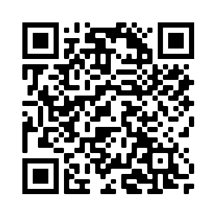
Thank you!
Support available now and coming up in the programme is available on the Trust-wide improvement hub, scan the QR code for access:

