Slide 1
Foundation Group Journey
Glen Burley, Chief Executive
The Foundation Group
South Warwickshire FT
George Eliot NHST
Wye Valley NHST
Notes:
12,000 staff circa £1bn
Integrated
Distance between us means focus on sharing not reconfiguring
Logo
Group is a system in itself

Slide 2
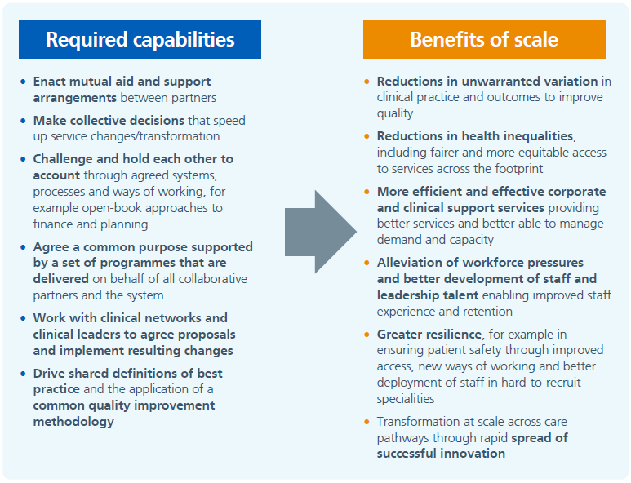
Provider Collaboratives - Benefits

Slide 3
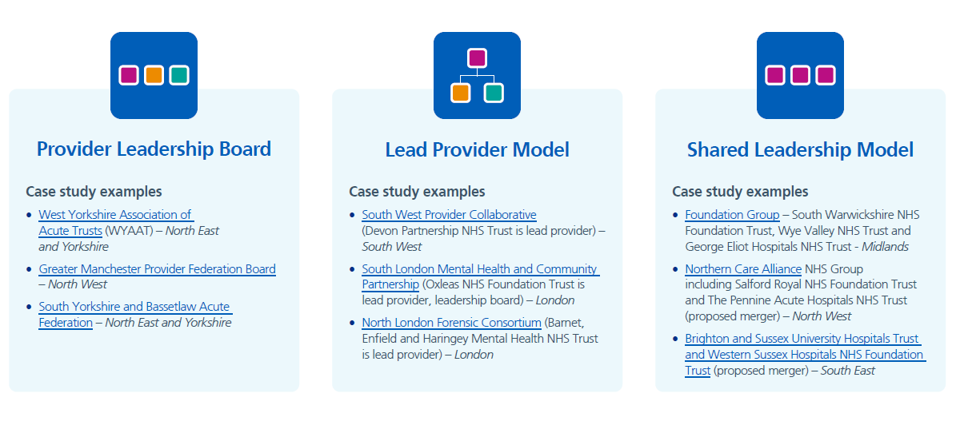
Types of Provider Collaborative

Slide 4
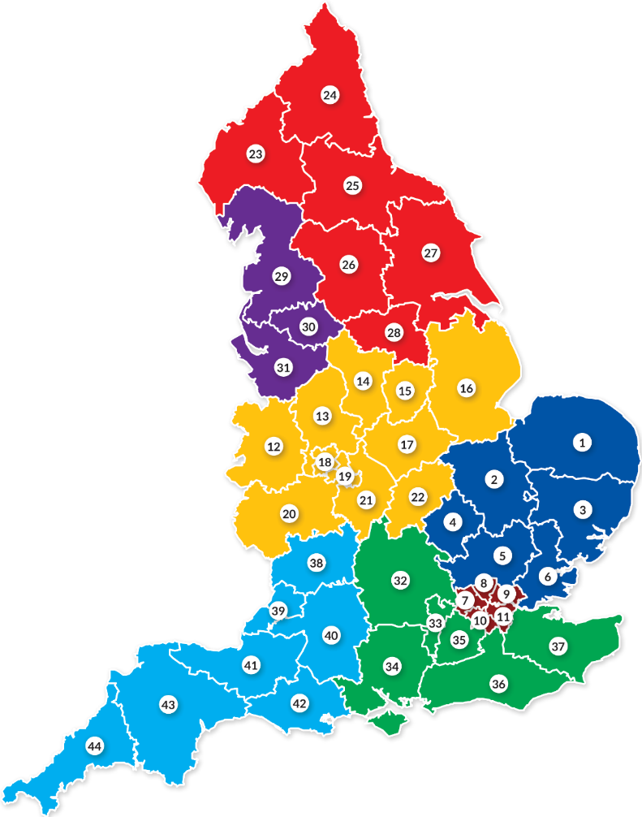
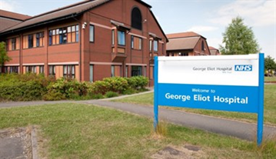

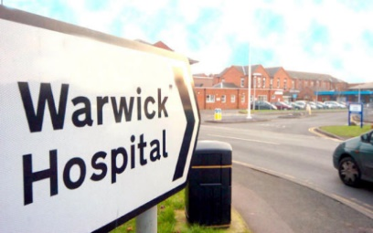
The Foundation Group
Turnover £210m 3,000 staff
Turnover £295m
4,100 staff
George Eliot Hospital NHST
Turnover £370m
5,200 staff
Wye Valley NHST
South Warwickshire NHS FT

Slide 5
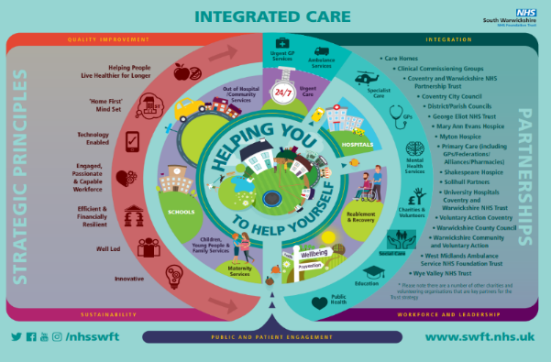
Shared Leadership form of PC
Built out of South Warwickshire FT
Trusts with common challenges and strategies
  Working across 2 ICSs with wider Provider Collaboratives
  Each member Trust is taking on a Place Lead Provider role
  ‘Sharing best practice at pace’; delivery and integration
  Benchmarking, ‘relentless pursuit of excellence’
  Increasing leadership capacity and capability
  Doing things once
Not a merger
  Each Trust maintains sovereignty and accountability and their organisational culture
  Common CEO and Chair with Managing Directors in each
  Committee in common (Group Strategy Committee)
  Using arms length company providing consultancy and some services to all
Notes:
Types of PC – Provider Leadership Board, Lead Provider and Shared Leadership – in all 3
Could be called ‘Academy Style’
Nominate Execs as accountable even when another Trust in the Group is leading

Slide 6
Operating Model
Associate Member
WHAT Board

Slide 7
Foundation Group
Progress and Next Steps
Glen Burley, Chief Executive
The Foundation Group
South Warwickshire FT
George Eliot NHST
Wye Valley NHST
Notes:
12,000 staff circa £1bn
Integrated
Distance between us means focus on sharing not reconfiguring
Logo
Group is a system in itself

Slide 8
Progress
Sharing Best Practice through Group Strategy Committee and ‘3 Boards’ development meetings
Single virtual Grand Round
Advisory roles – Strategic Finance, Strategy, Improvement, Digital, OD
Executive portfolio alignment and informal networks of Execs and NEDs
Group work on Prevention strategies
Group-wide Improvement Network and database
Digital Innovation Hub (in SWFT) in partnership with Technology Partners
Aligning research strategies
Common Board performance pack moving to combined quarterly Board meetings
Regular Managing Director forum to share ideas and effort
Shared back offices (mainly virtual) – Procurement, Financial Services, IT (SWFT and GEH)
Gradual harmonisation of policies and procedures
Notes:
Provider collaboratives offer scale and ideas sharing which can improve the performance of all

Slide 9
Operating as a ‘host’ provider
Sharing experiences and models across the Group
Governance is a necessary ‘evil’ but not an outcome in its own right
Clearly no one way to structure this, equally we will not get it right first time
We should be judged by what we do with partners
ICS should be the servant of Place and hence we should spend more time there
Big changes in risk as the host model evolves
  initially the service range will be narrow and familiar but this should change over time, particularly if successful
  Trusts will need to be clear about the risks that they are directly taking on with others being passed to partners
  Keen to avoid feeling like we’ve reinvented the CCG
Mindset of host provider really key, not sole provider
Need to demonstrate to other partners (especially primary care) that you can operate responsibly

Slide 10
Host Provider Initial Moves - We will…
Involve Primary Care
Involve primary care in leadership roles and change our structures to focus more on Place
Deliver on promises
Deliver on the national plan promise to invest more in mental health care
Prioritise
Prioritise business cases which deliver activity reductions or public health benefits
Incentivise
Incentivise primary care to reduce acute demand
Draw on skills
Draw on the skills of local authority commissioners to reduce the cost of continuing healthcare
Support the VS
Support the voluntary sector and local hospices including developing integrated IT and records
Use intelligence
Turn data into intelligence to improve public health outcomes with key partners
Develop skills
Facilitate the development of skills and roles in the wider health and care workforce
Trusted advice
Be a trusted source of evidence to our communities to support healthy lifestyle choices
Anchor
Take decisive action to reduce carbon emissions and act as an anchor institution at Place

